Slide 1
Data Analysis 1 (Python)
Reading files, summarising and describing data, Correlation and covariance
Files inc. in: https://github.com/kimieta/EvolveProgram-PythonDataAanlysis/tree/987a51aff185124ffef883a5e0c1b19c8bb12b4c/Session1

Slide 2
Contents
Reading files
CSV files
Text files
Excel files
Files from a different working directory
Python built in datasets
Summarising and describing data
Measures of central tendency
Measures of variability or dispersion
Correlation and covariance

Slide 3
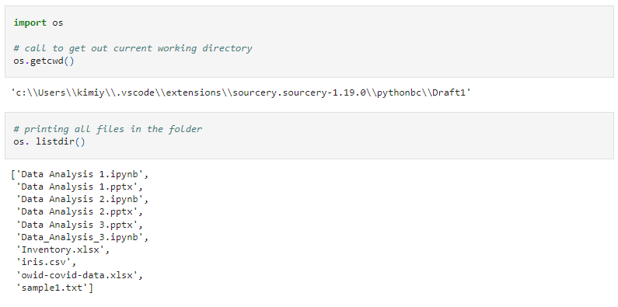
Importing libraries & working directory

Slide 4
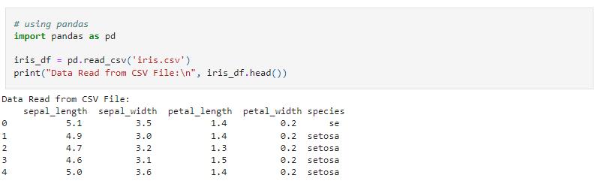
Reading a CSV file
Stores tabular data in plain text
Text file format that uses commas to separate values
Newlines to separate records
Typically each line represents one data record
Get file column names (.columns or .keys)
Call column
Call a row at index (.iloc - used when choosing rows and columns based on specific positions)
Call rows given certain criteria (.loc -used when we want to select rows and columns based on their labels)

Slide 5
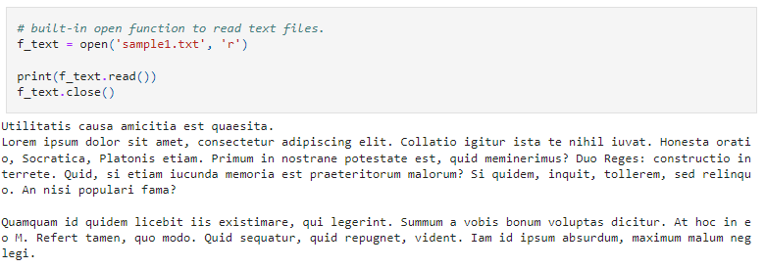
Reading a Text file

Slide 6
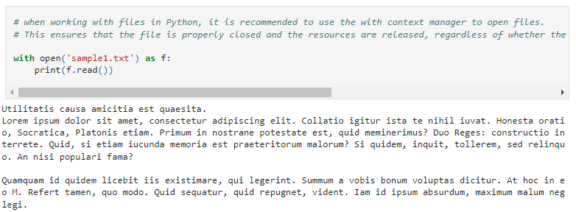
When working with files in Python, it is recommended to use the “with context manager” to open files. This ensures that the file is properly closed, and the resources are released, regardless of whether the program runs successfully or an exception occurs during the file operations.

Slide 7
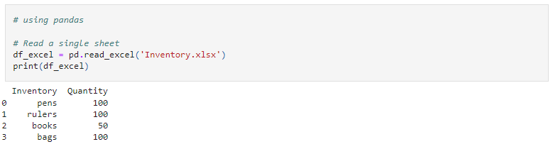
Reading an Excel file

Slide 8
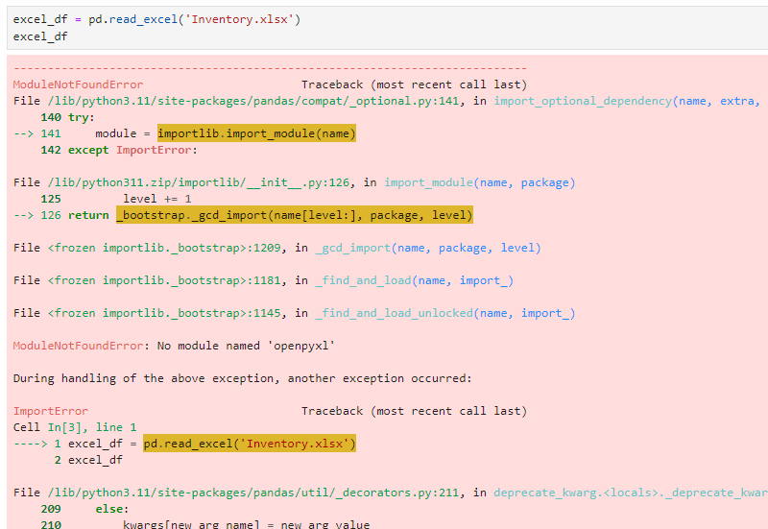
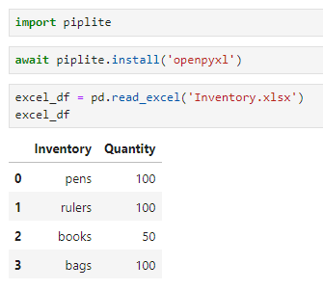
Common error

Slide 9
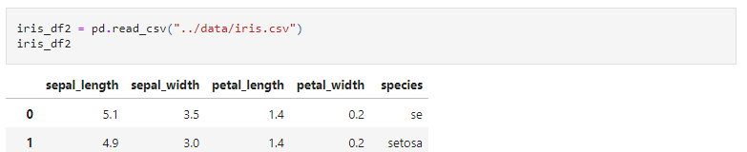
Reading data from a different working directory
Method 1: Include the file path, this is very simple
We specify the path to the “data" folder relative to our current working directory. If the "data" folder is located at the same level as the “pythonbc" folder, the relative path will be ../data.

Slide 10
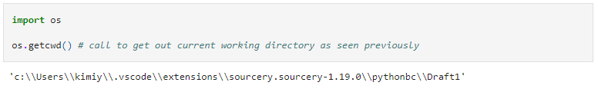
Method 2: Change our working directory (useful to know)
This requires the OS package which provides easy functions that allow us to interact and get Operating System information. For more information see https://docs.python.org/3/library/os.html
In order to find a file in a different working directory:
Check your current Working Directory
Specify the Path to the Data Folder
Read the CSV File

Slide 11
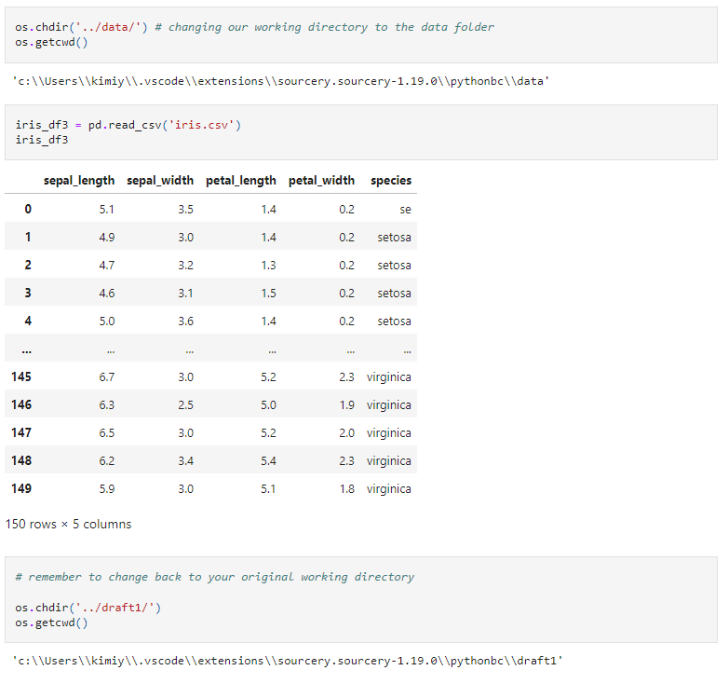

Slide 12
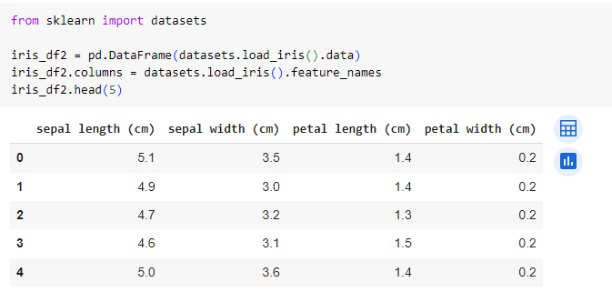
Python built in datasets

Slide 13
Summarising and Describing Data
Descriptive statistics include:
Measures of central tendency (centre position of a distribution for a data set)
Mean
Median
Mode
Measures of variability or dispersion (spread of distribution)
Variance or standard deviation
coefficient of variation
minimum and maximum values
IQR (Interquartile Range)
skewness and kurtosis

Slide 14
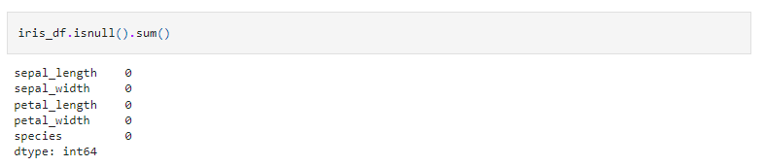
Checking for any null values

Slide 15
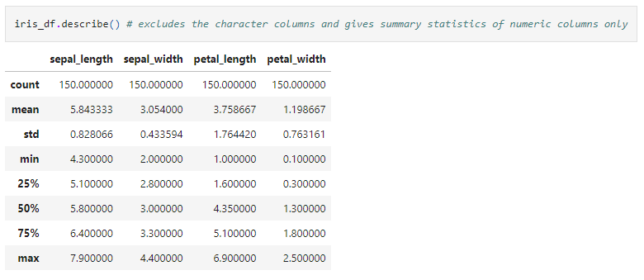
Describe() function

Slide 16
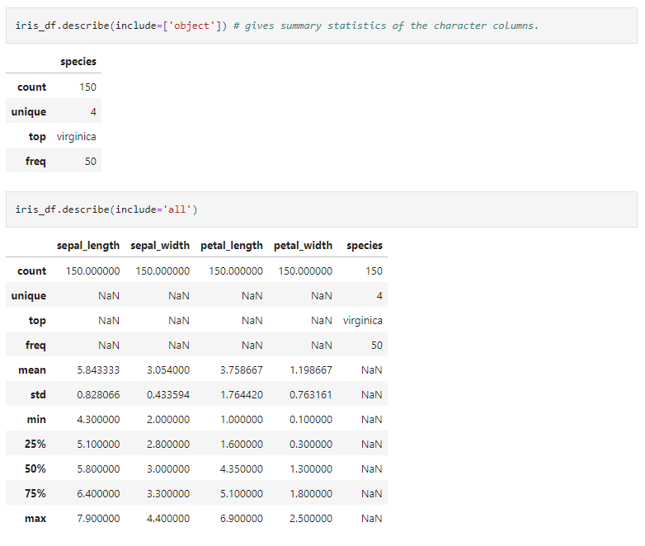

Slide 17
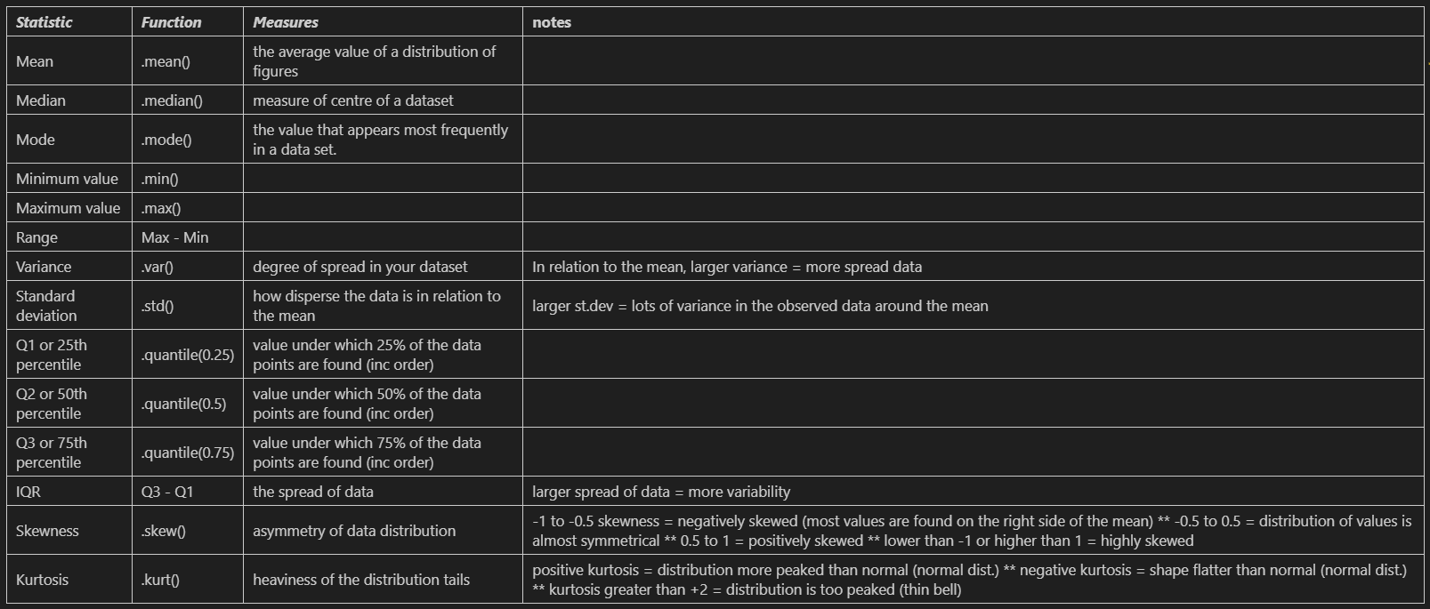
Different Measures

Slide 18
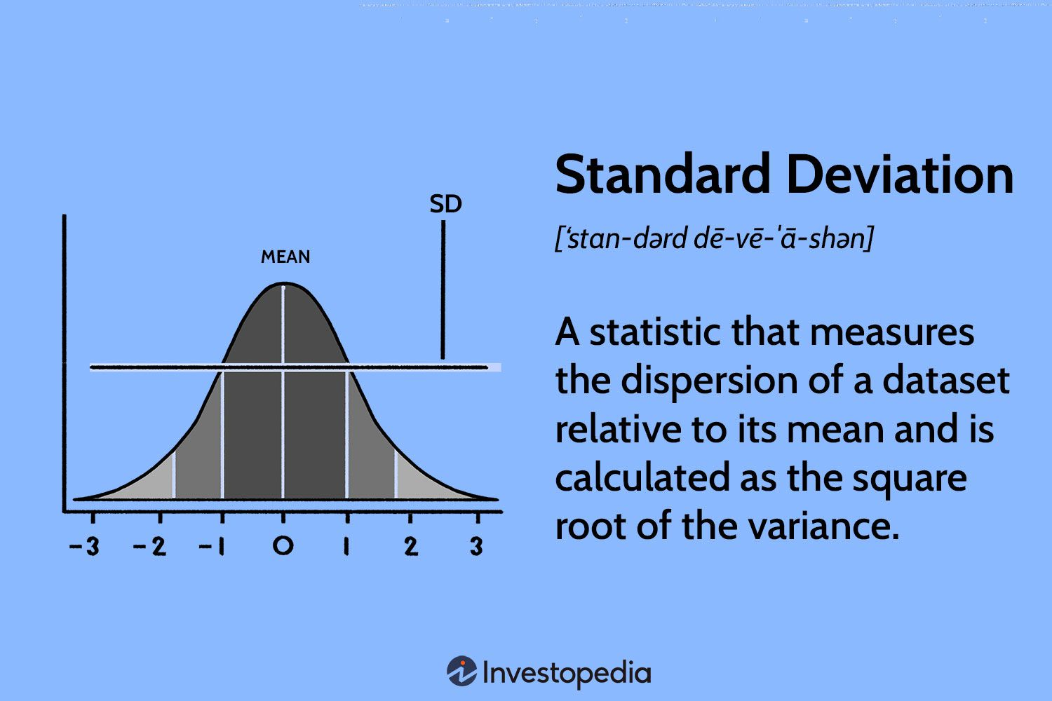
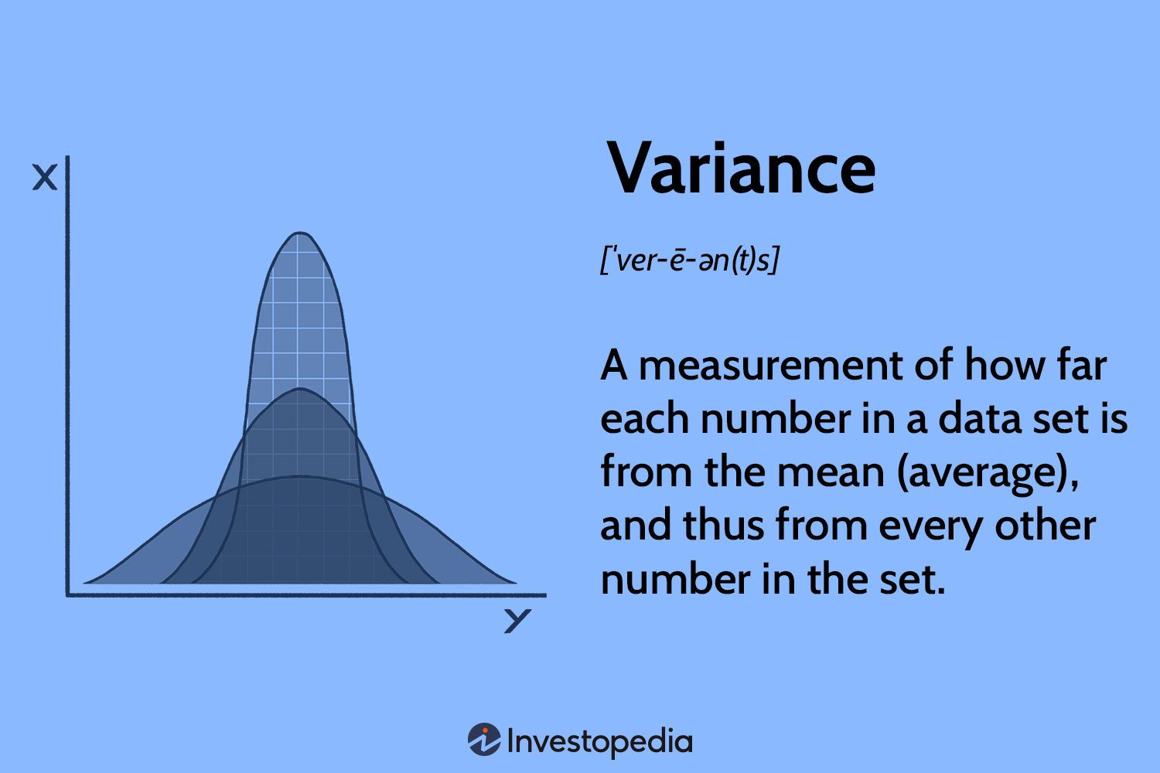

Slide 19
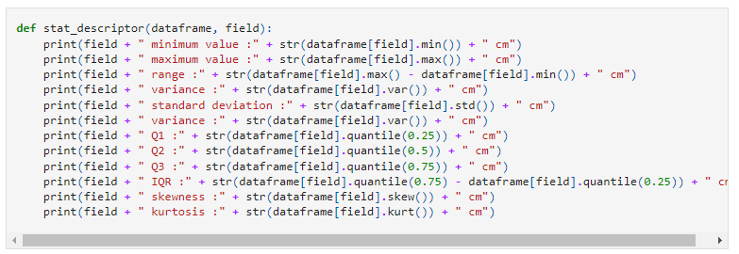
Quick function to show all basic statistical measures

Slide 20
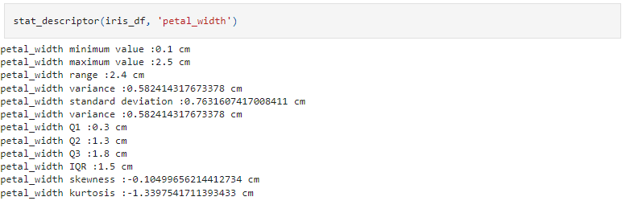

Slide 21
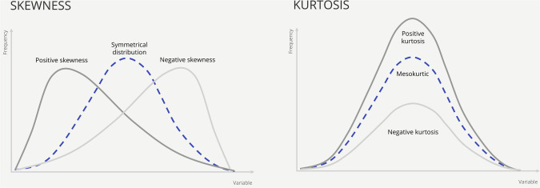
Skewness and Kurtosis
Skewness indicates the degree of tilt in data, whether it leans towards the left or right, exposing any asymmetry present. A positive skew indicates a tail extending towards the right, whereas a negative skew leans in the opposite direction. Kurtosis, on the other hand, focuses on the distribution's peaks and tails.

Slide 22
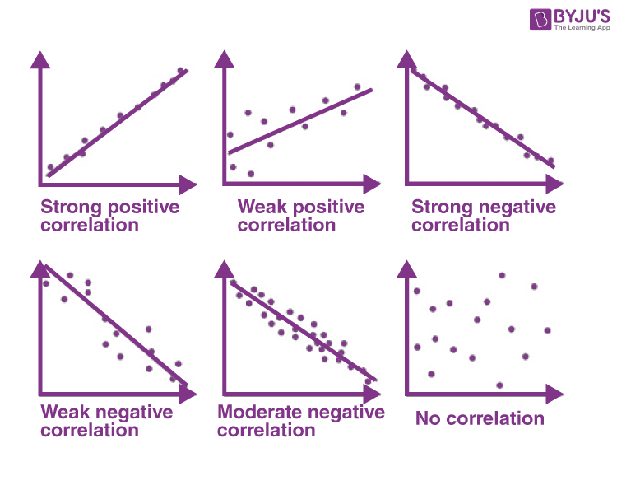
Correlation
standardized measure of the linear relationship between two variables
quantifies the strength and direction of the relationship on a scale from -1 to +1
+1 indicates a perfect positive linear relationship
-1 indicates a perfect negative linear relationship
0 indicates no linear relationship
unitless and not affected by the scale or units of the variable (easier to compare strength of relationship)

Slide 23
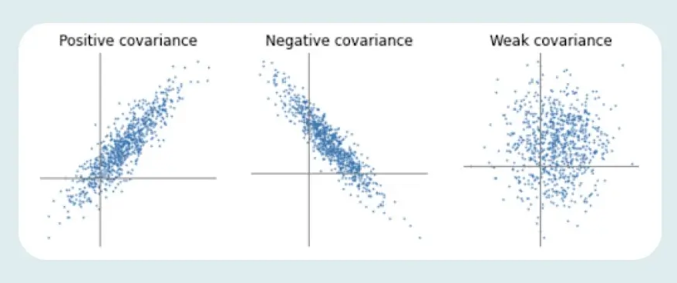
Covariance
measure of the linear association between two variables (measures how changes in one variable are associated with changes in another variable)
positive = variables tend to move in the same direction
does not provide a standardized measure and is sensitive to the units of the variables

Slide 24
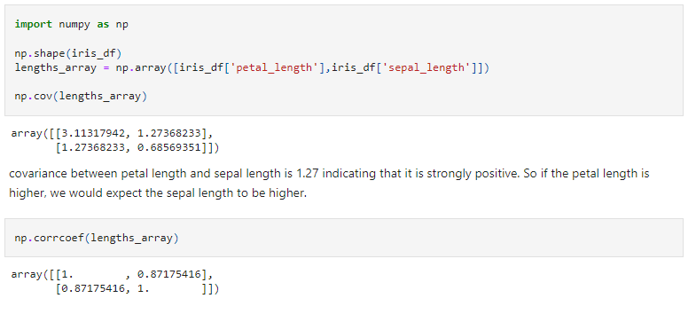

Slide 25
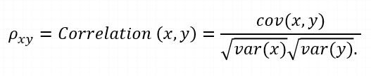

 | Covariance | Correlation
 | Let Σ(X) and Σ(Y) be the expected values of the variables, the covariance formula can be represented as:
Where | xi = data value of x yi = data value of y x̄ = mean of x ȳ = mean of y N = number of data values | var(X) = standard deviation of X var(Y) = standard deviation of Y
Definition | Covariance is an indicator of the extent to which 2 random variables are dependent on each other. A higher number denotes higher dependency. | Correlation is a statistical measure that indicates how strongly two variables are related.
Values | The value of covariance lies in the range of -∞ and +∞. | Correlation is limited to values between the range -1 and +1
Change in scale | Affects covariance | Does not affect the correlation
Unit-free measure | No | Yes

Slide 26
File links
Session1: (mock data)
https://github.com/kimieta/EvolveProgram-PythonDataAanlysis/blob/ca6fbb06dffd9a502f90c9a29c5994cfd7e4b568/Session1/session1.ipynb
Data Analysis 1: (using the iris dataset)
https://github.com/kimieta/EvolveProgram-PythonDataAanlysis/blob/ca6fbb06dffd9a502f90c9a29c5994cfd7e4b568/Session1/Data%20Analysis%201.ipynb

